Slide 1
Research Project
Pictorial Representation

Slide 2
Shows the list of databases used for the project

Slide 3
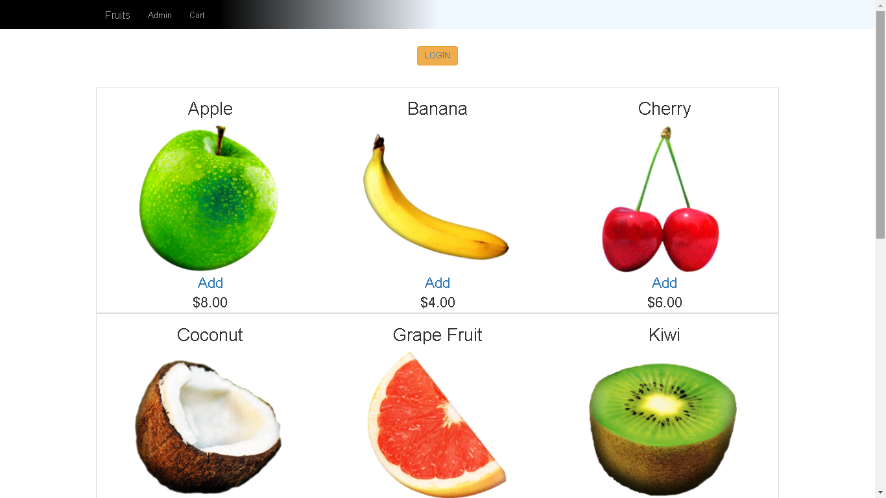
This is the main screen that the user will get once the program is started. At this Screen the user is able to log in.

Slide 4
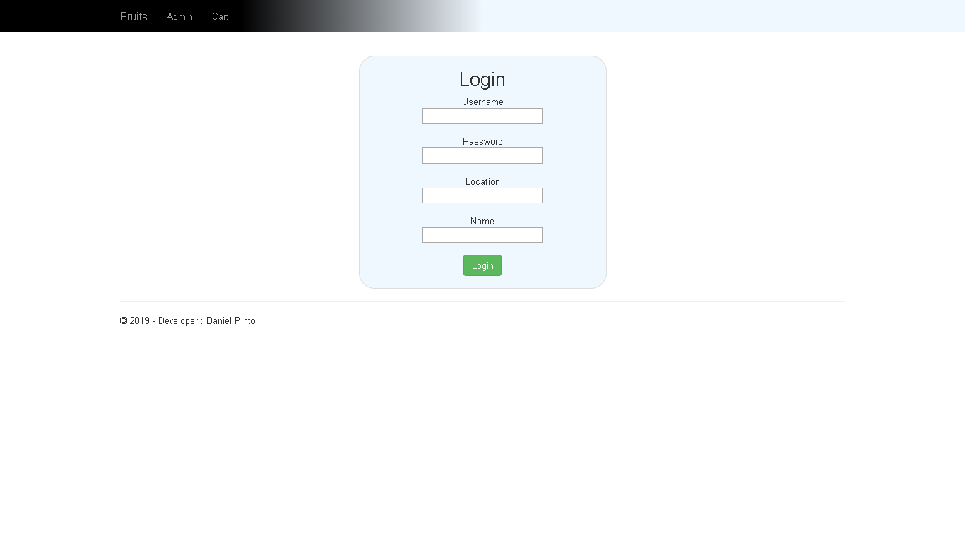
The system requires username, password, location and a name to be able to gain access to the system to be able to order snacks.

Slide 5
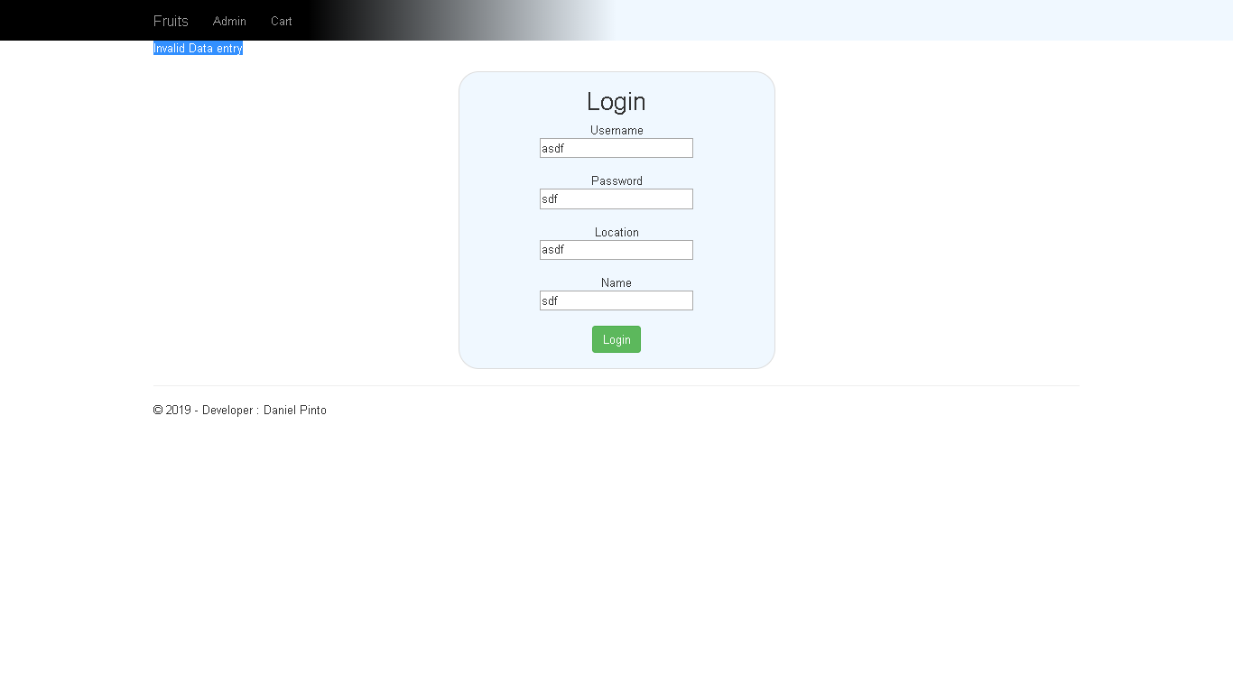
The system checks the validity of the information supplied.

Slide 6
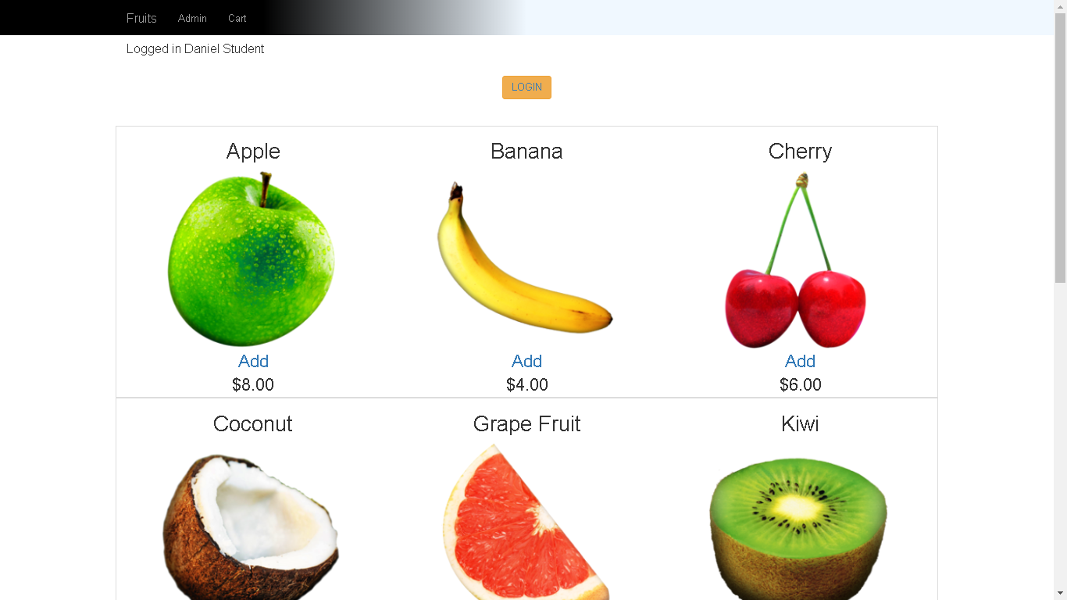
The system will highlight the type of user logged in. In this instance a registered user is logged in.

Slide 7
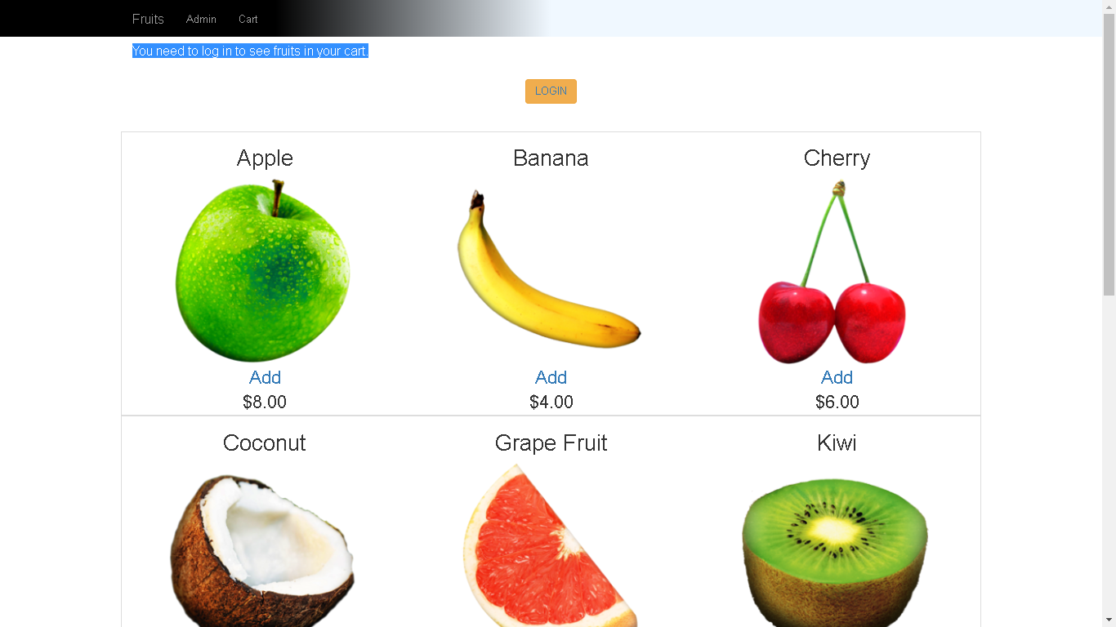
The system gives an error message if the user tries to view the cart if they are not logged in.

Slide 8

The system also informs the user when an item is added to the cart

Slide 9
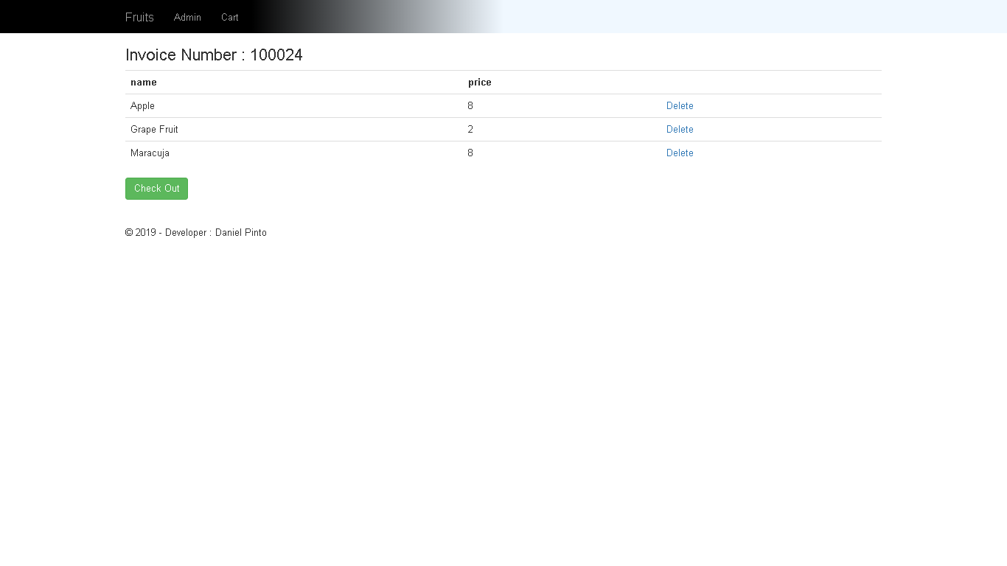
Once the user is selects the snacks they are interested in, then they are able to preview what their order will look like.

Slide 10
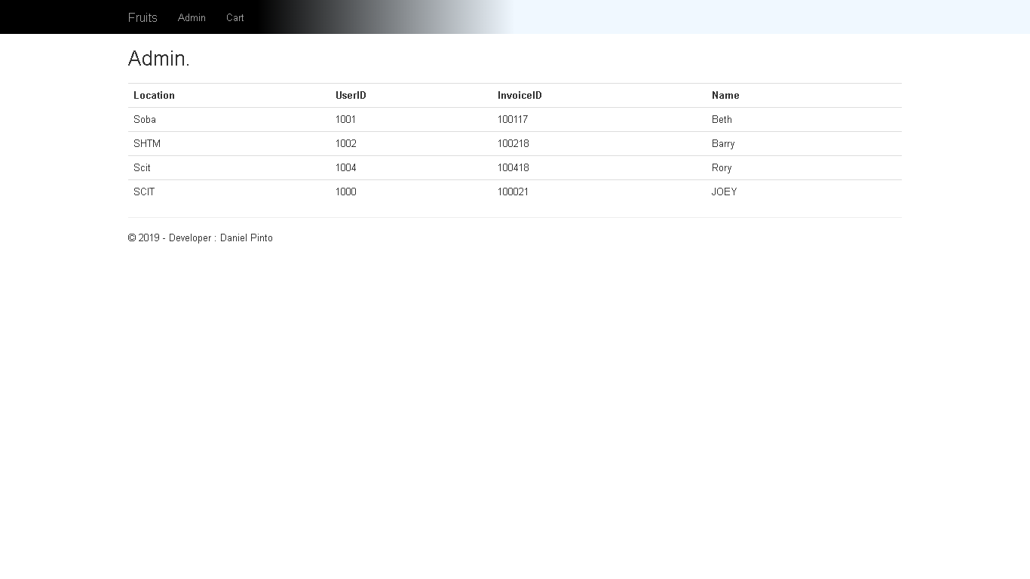
This is the administrative view, where a list of orders can be viewed.

